Slide 1
2006 Plans Discussion
Gap Strategic Overview

Slide 2
Executive Summary
Gap struggling with Retail 2010 issues
The Gap is experiencing a 2010 identity crisis: Mass and luxury retailers continue to see growth while the middle is squeezed:
  GAP Sept YTD Comps -5.0%
  Target Sept YTD Comps 6.3%
  Nordstrom Sept YTD Comps 6.1%
  Neiman Marcus Sept Monthly Comps 9.3%
Specialty apparel as whole has experienced lack lustre performance with negative and mostly flat comps. Both The Limited and Ann Taylor are at -3.0%. However, A&F at 24.0%and AEO at 20.1%continue to post strong numbers by focusing on the young adult market .
2005 has seen a retrenchment in BCS revenue and profit and IBM overall revenues
2004 was a high watermark for BCS ($16M) and IBM ($103M) during which several major projects were completed (Oracle, PFI integration, BCS; POSabilities Rollout RSS/ITS), and key BCS project losses sustained (HR & Process Design for International Footprint)
In 2005 Gap Direct (multi-channel solutions) has been the strongest BCS revenue stream; and will account for $5.3 or 66% of total projected 2005 BCS $8.1. MDS project related write down of $1M+ has caused account profitability to suffer. The projected year end CGP is 9%.
2005 has opened new windows of opportunity
IBM and Gap have begun due diligence around infrastructure outsourcing and joint review of select BTO opportunities such as HR eRecruiting and Supply Chain Inbound Logistics
2006 BCS focus will be selling core retail solutions, BTO drag and select BCS opportunities
Continue to deliver and evolve the Gap Direct relationship as GID capability and assortments expand.
Define value proposition for BCS within the context of outsourcing / BTO contracts
Success Factors for 2006
Identify opportunities to leverage MDBT or other opportunistic value propositions to gain inroads to Merchandising System work.
Define a role for BCS within BTO and SO opportunities to ensure mutual success.

Slide 3
Buying Environment
Gap Strategic Priorities:
NSI / SSI application transformation initiatives to enable division specific footprints
International expansion
GID capability expansion
Cost management: Infrastructure modernization
Business Capability Improvement: Core merchant application transformation
Explore the business value of outsourcing non core business processes
Competitive Landscape Footprint:
Accenture continues to be the partner of choice for merchandising systems integration.
Bearing Point (HR) & CGEY(PLM) have made some competitive inroads.
Infosys & Covansys are providing application development and support.
IBM Footprint, Solutions Focus, and Opportunity Areas:
Currently engaged: AIS support for application integration and AIS support for multi-channel application development
NSI / Integration layer, non core enterprise processes
MDBT follow on work
Gap Direct WMS
Investigate opportunities to drive store business, training and recruiting solutions

Slide 4
Buying Environment
Critical Client Relationships Dedicated IBM Resource Needs:
Senior Executive commitment to GAP
Engage Joe Gagnon to build relationships for BCS within the Brand Organizations.
Global Account Team
Patrick O'Donnell, Client Executive
Michael Ziegler, Client Executive
Michael Mcglinchey, Client Services manager
BCS Team
Whitney Walker, Relationship Lead
Kelly Chambliss, Gap Direct Lead (On Leave)
Larry Salmela, AP, Gap Direct Relationship Lead
Steve Luce, SME
Steve Schlabs, FMS / HR Relationship Lead

Slide 5
Client Development Objectives/Strategy
Focus on maintaining a strong pipeline with Gap Direct, and position for possible WMS work.
Identify BCS opportunities associated with NSI / SSI transformation
Gain better understanding of Accenture’s performance and role within process design to better position for merchandising opportunities
Identify BCS opportunities associated with BTO plays
Develop relationships with clients inside supply chain and the brand organizations to identify project add ons not associated with BTO and SO contracts
Develop joint solutions with ISV incumbents Oracle, MatrixOne, i2, WorkBrain (tbd), Yantra, 360commerce

Slide 6
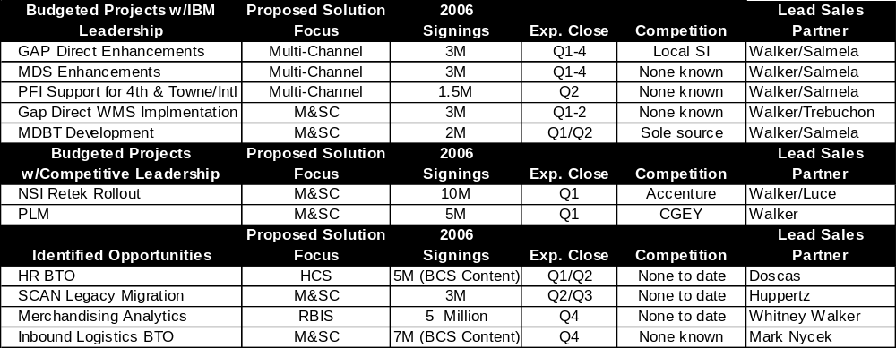
Opportunity Area/Solutions Roadmap

Slide 7
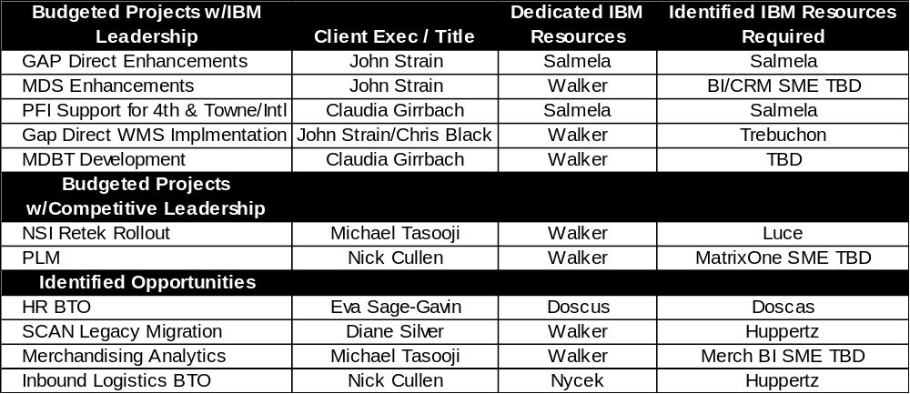
Resource Alignment and Allocation Map

Slide 8
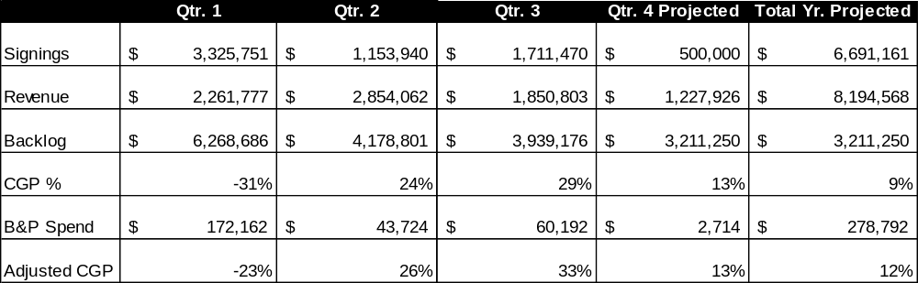
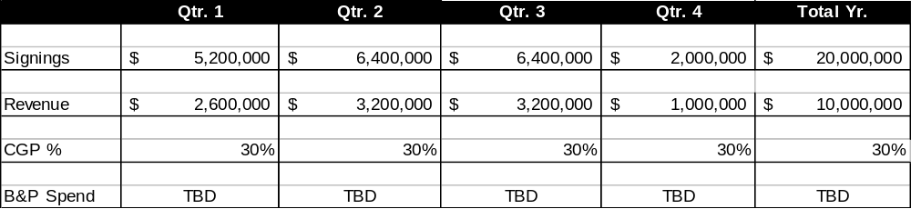
2006 Business Metrics
2005 Performance (YTD/Projected)
2006 Targets

Slide 9
Issues, Concerns
Identify qualified IBM subject matter experts to lead / assist in pursuing opportunities related to WMS, MDS – BI, PLM and MDBT
Negotiating the BCS role to achieve incentive alignment and mutually agreeable rate structure across SO and BTO
Securing proper level of investment to ensure continuity of resources at Gap Direct and to build upon existing relationships as billable project works comes to conclusion in Q1.

